Slide 1

Shadows
COMP4451 Game Programming

Slide 2
Contents
Hard shadows
Shadow volumes
Shadow maps
Soft shadows
PCF
Smoothies

Slide 3
Introduction
Why do we need shadows?
Shadows add visual information
Relative object positions in world.
The shape of the receiver object surface.
The light source position and shape.
So, shadows add realism to the scene!

Slide 4
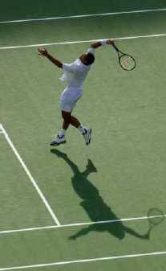
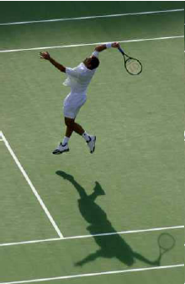
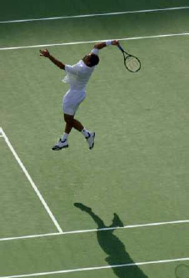
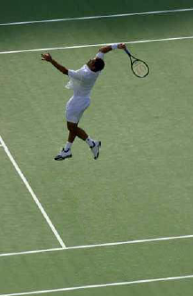
How high is the tennis player?
3 inches?
1 foot?
3 feet?
Stratosphere

Slide 5
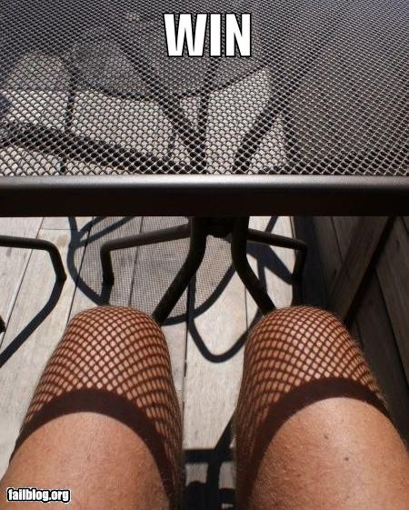
When should we NOT have shadows?

Slide 6
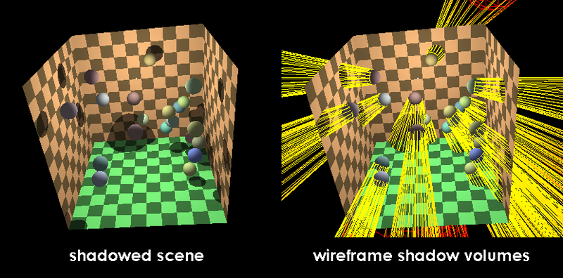
Introduction
Two main categories of Shadow Algorithms
Shadow Volume:
First proposed by Crow in 1977.

Slide 7
Introduction
Two main categories of Shadow Algorithms
Shadow Volume:
Accurate to the pixel.
Connectivity information of all polygons are required to compute the silhouette of each shadow caster.
The scene complexity thus directly influence the performance due to the object-based nature.

Slide 8
Introduction
Two main categories of Shadow Algorithms
Shadow Volume:
Shadowing object
Light source
Shadow volume
(infinite extent)
A shadow volume is
simply the half-space intersection defined
by a light source and a shadowing object.

Slide 9
Shadow Volume Basics
Surface outside shadow volume
(illuminated)
Simple rule:
samples within a
shadow volume
are in shadow.
Partially
Surface inside shadow volume
(shadowed)
shadowed
object

Slide 10
Eye-to-Object Stencil Counting
Light source
Shadowing object
zero
+1
zero
+2
+2
Eye position
+1
+3

Slide 11
Illuminated, Behind Shadow Volumes (Zpass)
Light source
Shadowing object
zero
+1
zero
+
+
+
-
-
-
Unshadowed object
+2
+2
Eye position
+1
+3
Shadow Volume Count = +1+1+1-1-1-1 = 0

Slide 12
Shadowed, Nested in Shadow Volumes (Zpass)
Light source
Shadowing object
zero
+1
zero
+
+
+
-
+2
+2
Shadowed object
Eye position
+1
+3
Shadow Volume Count = +1+1+1-1 = 2

Slide 13
Illuminated, In Front of Shadow Volumes (Zpass)
Light source
Shadowing object
zero
+1
zero
+2
+2
Shadowed object
Eye position
+1
+3
Shadow Volume Count = 0 (no depth tests pass)

Slide 14
GPU Implementation
Render scene to initialize depth buffer
Depth values indicate the closest visible fragments
Use a extra buffer (stencil buffer) to count:
Draw shadow volume twice using face culling
1st pass: render front faces and increment when depth test passes
2nd pass: render back faces and decrement when depth test passes
Don’t update depth or color
Afterward, pixel’s count is non-zero if pixel in shadow, and zero if illuminated

Slide 15
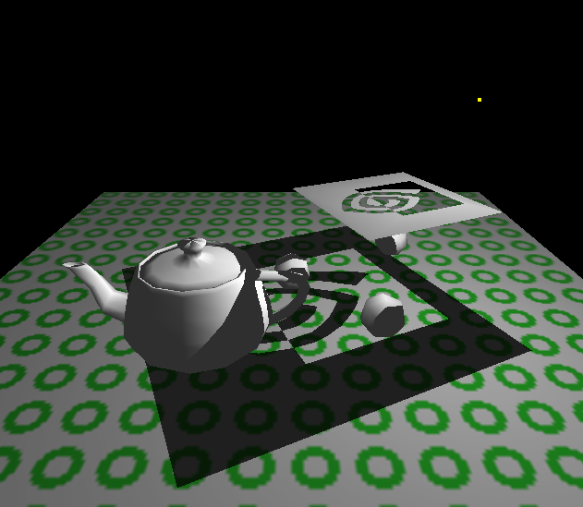
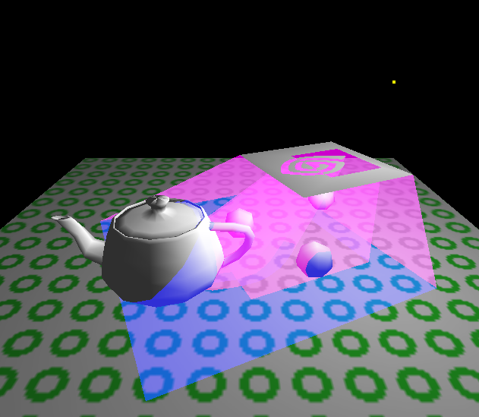
Visualizing Shadow Volumes in 3D
Light source
Scene with shadows from an NVIDIA logo casting a shadow volume
Visualization of the shadow volume

Slide 16
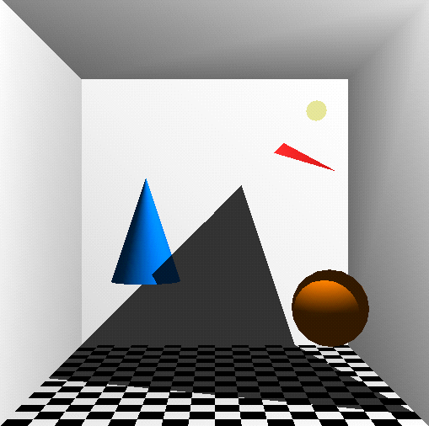
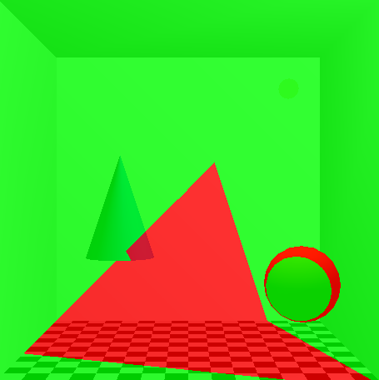
Visualizing the Stencil Buffer Counts
Shadowed scene
Stencil buffer contents
Stencil counts beyond 1 are possible for multiple or complex occluders.
red = stencil value of 1 green = stencil value of 0
GLUT shadowvol example credit: Tom McReynolds

Slide 17
Introduction
Shadow Mapping:
First proposed by Williams in 1978.
First step: Render from the light’s point of view to generate shadow map.
The shadow map contains scene depth values from the current point of view.
Second Step: Render the scene from the eye’s point of view:
Transform the current position into light space, and compare its depth values with the depth values stored in the shadow map.

Slide 18

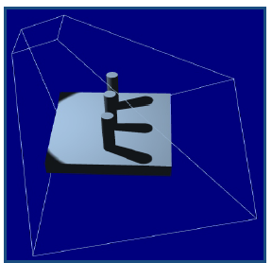
Shadow Mapping basics
Shadow Mapping:
First Step
Light
Second Step
Shadow Map
Scene rendered using Shadow Map

Slide 19
Shadow mapping basics
Shadow Mapping:
Works in the light space.
Requires only one additional rendering pass per light.
Faster, but have problems with aliasing.
Very popular among games.

Slide 20
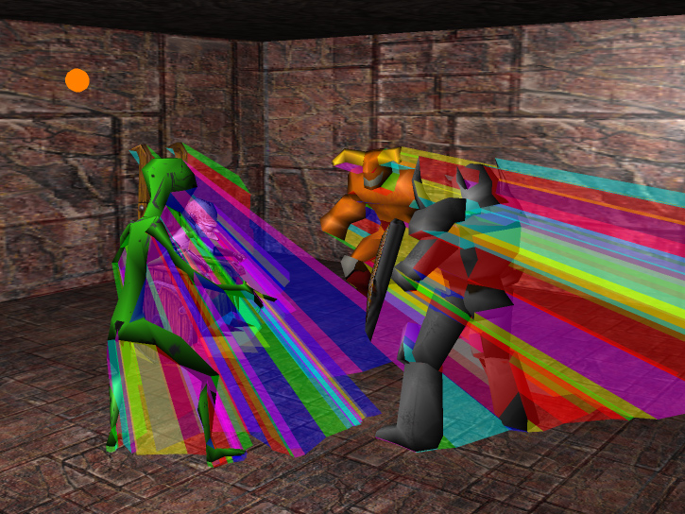
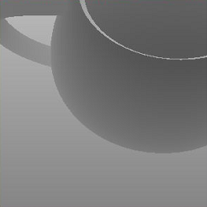
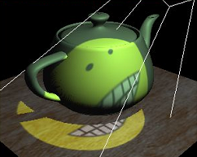
Summary of Shadow Algorithms
Shadow maps (Williams 1978)
fast and simple
undersampling artifacts
lots of recent research!
Shadow volumes (Crow 1977)
object-space
accurate
accelerated by stencil buffer
high fill-rate consumption!
NVIDIA

Slide 21
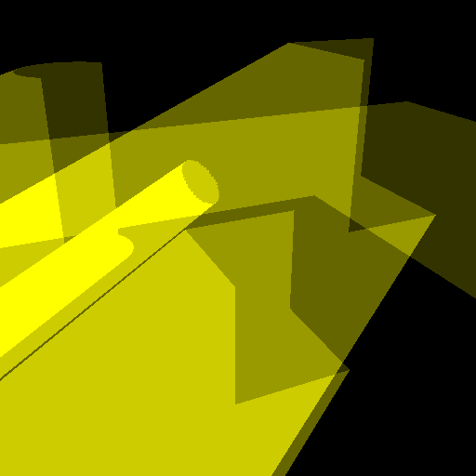
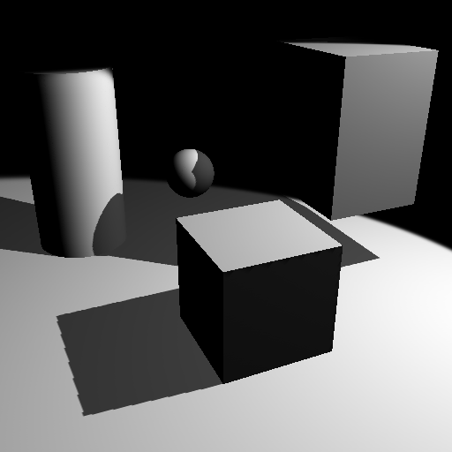
Fillrate Problem
Lots and lots of fillrate!
rasterization
stencil updates
Why?
polygons have large screen area
polygons overlap
But is this really a problem?

Slide 22
How important are shadows?
Case study: Doom 3 engine (id Software)
bump mapping
per-pixel surface shading
dynamic and projected lights
atmospheric effects
particle effects

Slide 23
How important are shadows?
Case study: Doom 3 engine (id Software)
bump mapping
per-pixel surface shading
dynamic and projected lights
atmospheric effects
particle effects
shadow volumes

Slide 24
How important are shadows?
Case study: Doom 3 engine (id Software)
bump mapping
per-pixel surface shading
dynamic and projected lights
atmospheric effects
particle effects
shadow volumes
50%
50%
“Shadowing accounts for about half of the game’s rendering time.”
— John Carmack

Slide 25
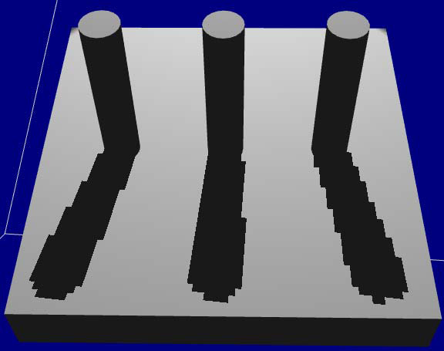
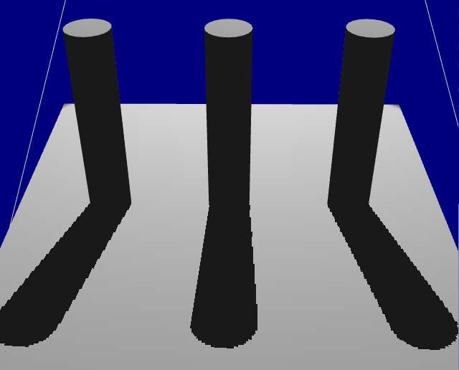
Shadow Mapping results not very realistic
Aliasing when shadow resolution is low
Hard transitions (does not address area light sources)

Slide 26
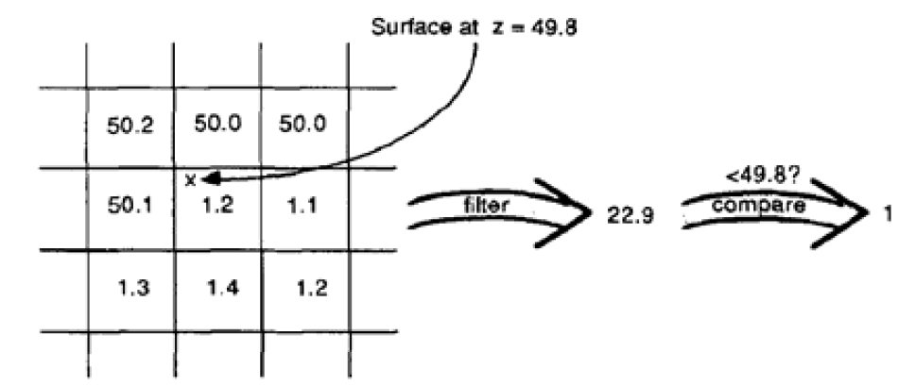
Percentage Closer Filtering
Should we filter (average) depth?
No. Filtering depth is not meaningful

Slide 27
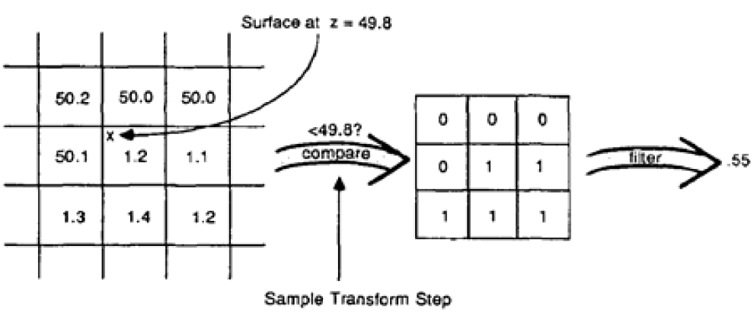
Percentage Closer Filtering
Can’t average depths
But can filter the result of the test

Slide 28
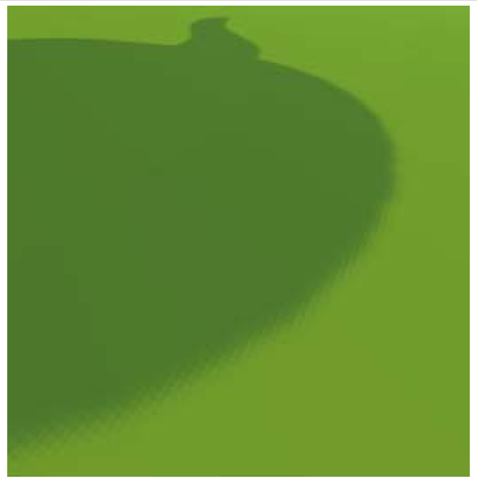
Percentage Closer Filtering
5x5 samples
Nice antialiased shadow
Using a bigger filter produces approximate soft shadows

Slide 29
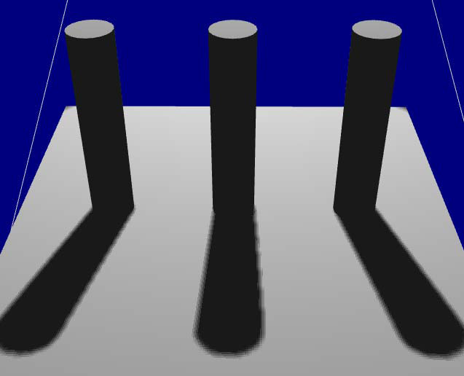
Percentage Closer Filtering
Single tap 4x4 PCF

Slide 30
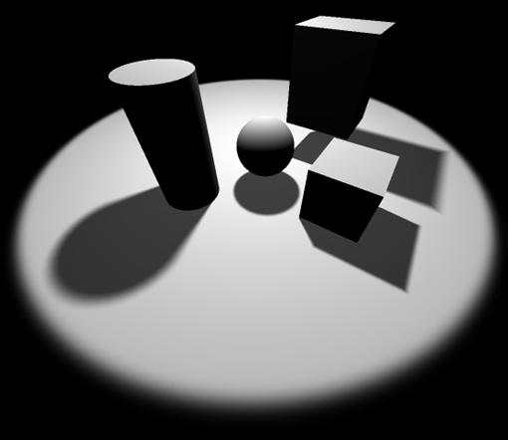
Rendering Fake Soft Shadows with Smoothies
Eric Chan Frédo Durand
Laboratory for Computer Science Massachusetts Institute of Technology

Slide 31
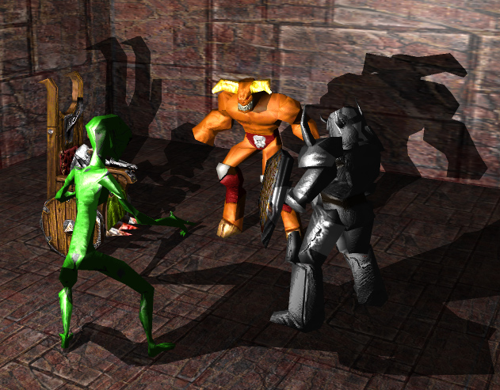
Real-Time Shadows
Goals:
Interactive framerates
Hardware-accelerated
Good image quality
Dynamic environments
Handle area light source
Applications:
Game engines
Interactive walkthroughs
Challenge: balancing quality and performance
NVIDIA

Slide 32
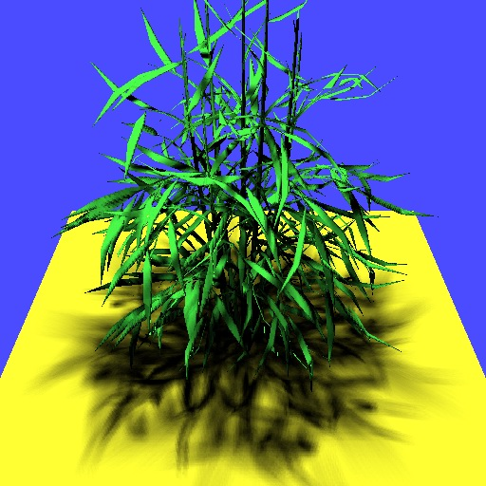
Soft Shadow Maps
Ideas:
Filtering
Stochastic sampling
Eg: PCF
But: need dense sampling to minimize artifacts
Agrawala et al.

Slide 33
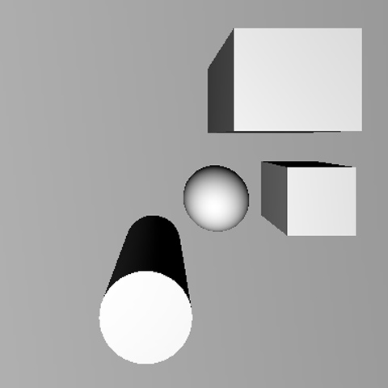
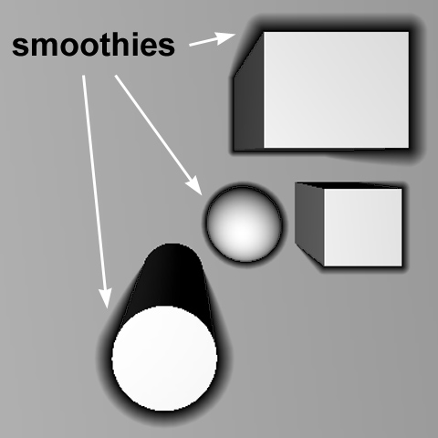
Overview
Extend basic shadow map approach
Use extra primitives (smoothies) to soften shadows
light’s view (blockers only)
light’s view (blockers + smoothies)

Slide 34
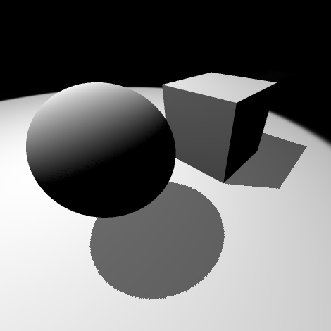
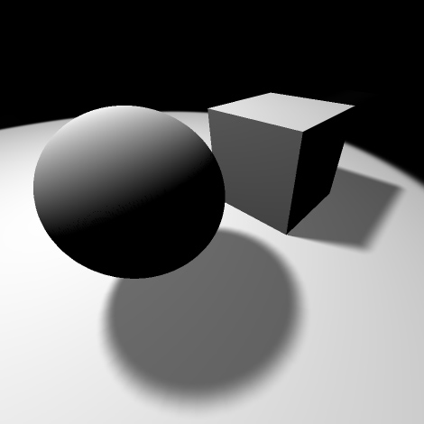
Fake Soft Shadows
Shadows not geometrically correct
Shadows appear qualitatively like soft shadows
Hard shadows
Fake soft shadows

Slide 35
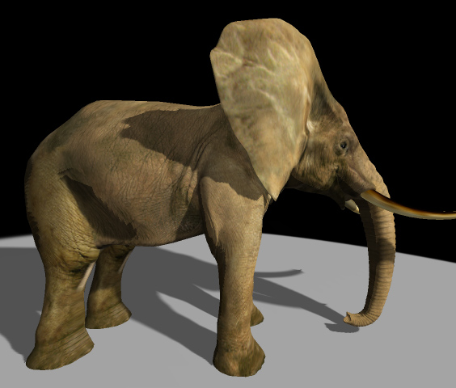
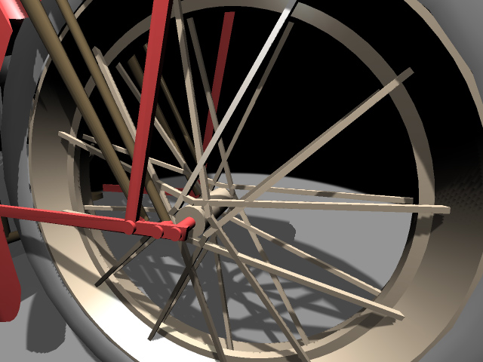
Contributions
Smoothie shadow algorithm:
Creates soft shadow edges
Hides aliasing artifacts
Efficient (object / image space)
Hardware-accelerated
Supports dynamic scenes

Slide 36
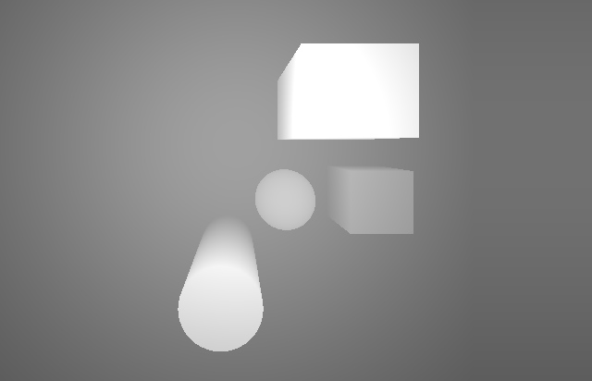
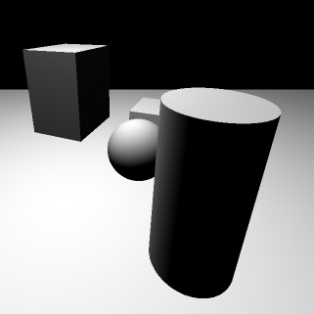
1. Create Shadow Map
Render blockers into depth map
observer’s view
light’s view

Slide 37
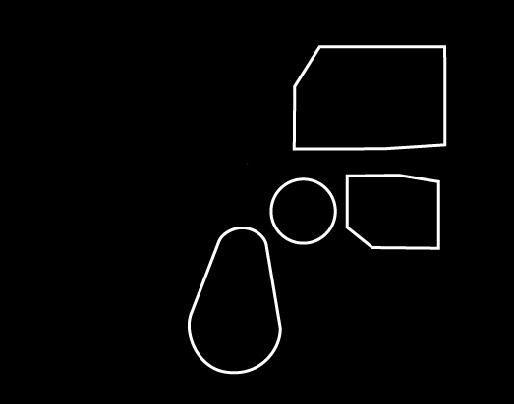
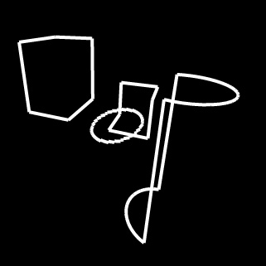
2. Identify Silhouette Edges
Find blockers’ silhouette edges in object space
object-space
silhouettes
observer’s view
light’s view

Slide 38
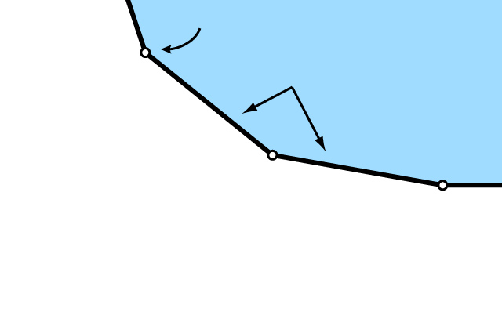
3. Construct Smoothies
Blocker only:
silhouette vertex
silhouette edges
blocker exterior

Slide 39
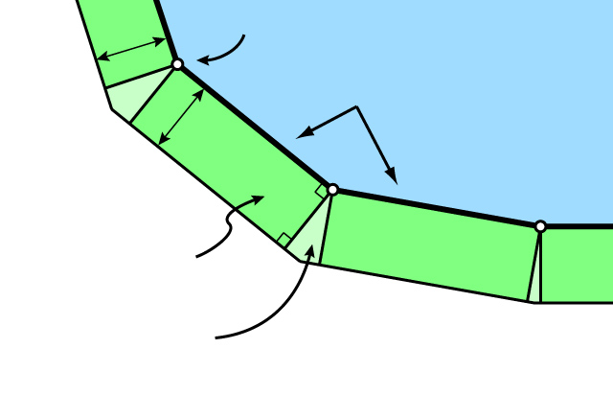
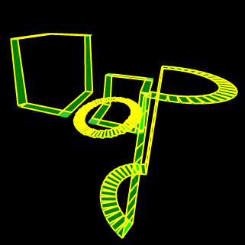
3. Construct Smoothies (cont.)
Blocker + smoothies:
silhouette vertex
t
silhouette edges
t
smoothie edge
smoothie corner
blocker exterior

Slide 40
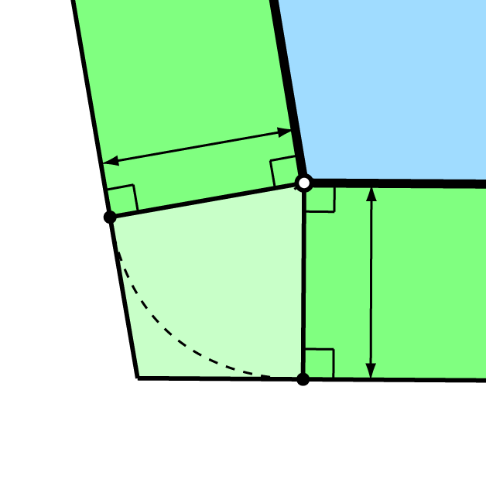
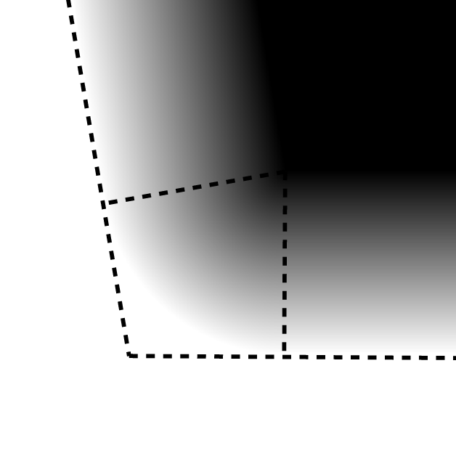
3. Construct Smoothies (cont.)
Smoothie edges are rectangles in screen space with a fixed width
Smoothie corners connect adjacent smoothie edges
t
t
geometry
shading

Slide 41

4. Render Smoothies
Store depth and alpha values into smoothie buffer
Smoothie Buffer (depth)
Smoothie Buffer (alpha)
light’s viewpoint

Slide 42
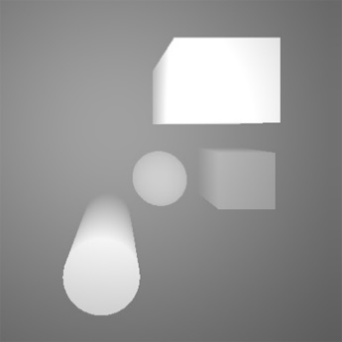
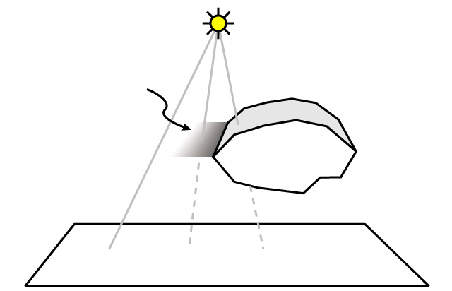


5. Compute Shadows
Compute intensity using depth comparisons
light source
smoothie
blocker
receiver

Slide 43
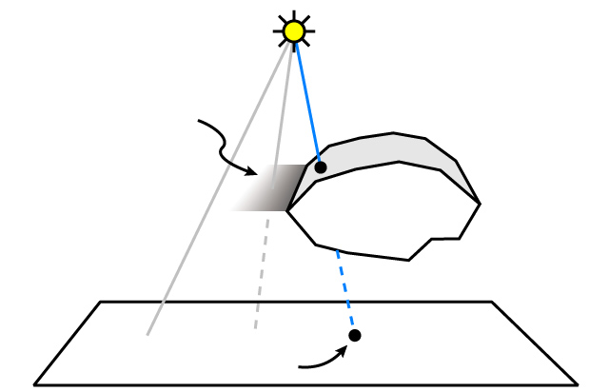
5. Compute Shadows
Image sample behind blocker (intensity = 0)
light source
smoothie
blocker
receiver
completely in shadow

Slide 44
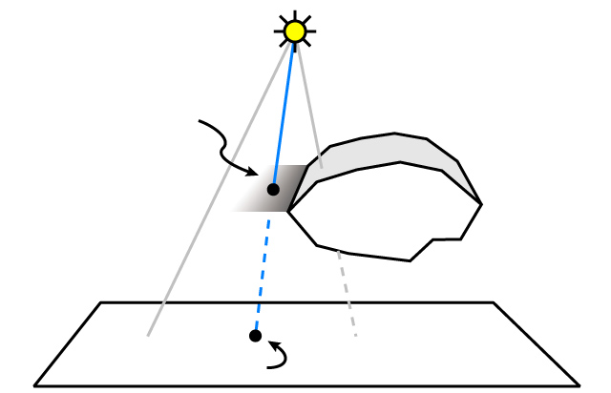
5. Compute Shadows
Image sample behind smoothie (intensity = α)
light source
smoothie
blocker
receiver
partially in shadow

Slide 45
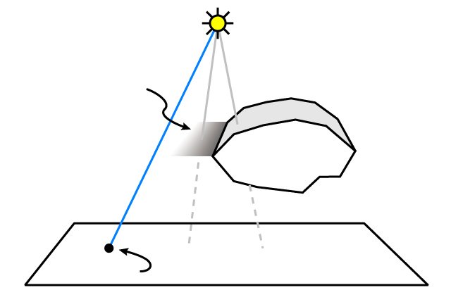
5. Compute Shadows
Image sample illuminated (intensity = 1)
light source
smoothie
blocker
receiver
illuminated

Slide 46
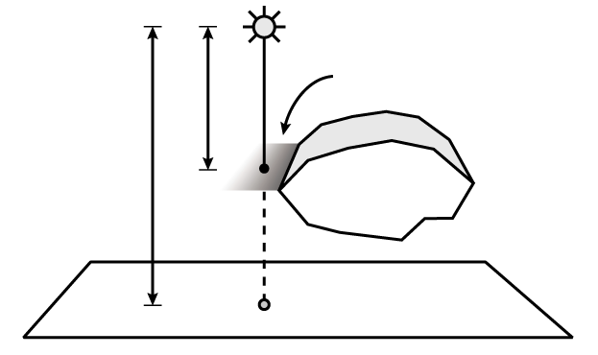
Computing Alpha Values
Intuition:
Alpha defines penumbra shape
Should vary with ratio b/r
light source
smoothie α
r
b
blocker
receiver

Slide 47
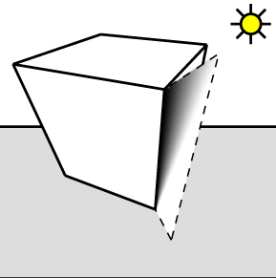
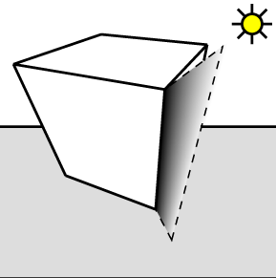
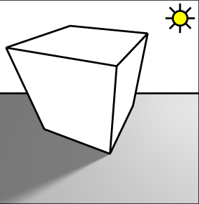
Computing Alpha Values (cont.)
Linearly interpolate alpha
Remap alpha at each pixel using ratio b/r:
α’ = α / (1 – b/r)
original α
remapped α
result

Slide 48
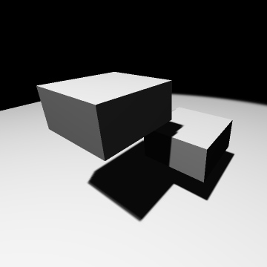
Multiple Blockers and Receivers

Slide 49

Multiple Receivers
Smoothie buffer
(linearly-interpolated α)
1
same thickness
2
light’s view

Slide 50

Multiple Receivers (cont.)
Smoothie buffer
(remapped α)
1
different thickness
2
light’s view

Slide 51

Multiple Receivers (cont.)
Final image
different thickness
observer’s view

Slide 52
Multiple Blockers
What happens when smoothies overlap?
smoothie overlap

Slide 53


Multiple Blockers (cont.)
Minimum blending: just keep minimum of alpha values
smoothie
ray tracer

Slide 54




Hiding Aliasing (256 x 256)
16 ms
129 ms
shadow map
bicubic filter
19 ms
19 ms
smoothie (t = 0.02)
smoothie (t = 0.08)

Slide 55




Hiding Aliasing (1024 x 1024)
17 ms
142 ms
shadow map
bicubic filter
22 ms
24 ms
smoothie (t = 0.02)
smoothie (t = 0.08)

Slide 56

Comparison to Ray Tracer
increasing size
of light source
smoothie
ray tracer

Slide 57

Video
original md2shader demo courtesy of Mark Kilgard

Slide 58

Summary
Contribution:
Simple extension to shadow maps
Shadows edges are fake, but look like soft shadows
Fast, maps well to graphics hardware

Slide 59
Final game video
Showcase your final game
A few slides and one or more demos
Describe technical details clearly
High quality narration
Consider
Background music
3m45s video hard limit (we will cutoff)
try to make it between 3m20s and 3m45s
Deadline May 6th at 11:59PM
Must be WMV format at 1920x1080 resolution (will be enforced in grading)
If cannot convert to WMV in that format, need to send it 24 hours earlier

Slide 60
Final game deliverables
Must submit code
Can also submit additional document at the same time
If you feel video not enough to showcase all your work
Poster for the demo
Three pages; similar to FYP formatting guidelines
Possible dates: May 13, 14, 15 afternoon

Slide 61
Acknowledgments
John Isidoro and Eric Chan for some of the slides

